Slide 1
Study Jam Machine Learning 3: Basic Python programming skills

Slide 2

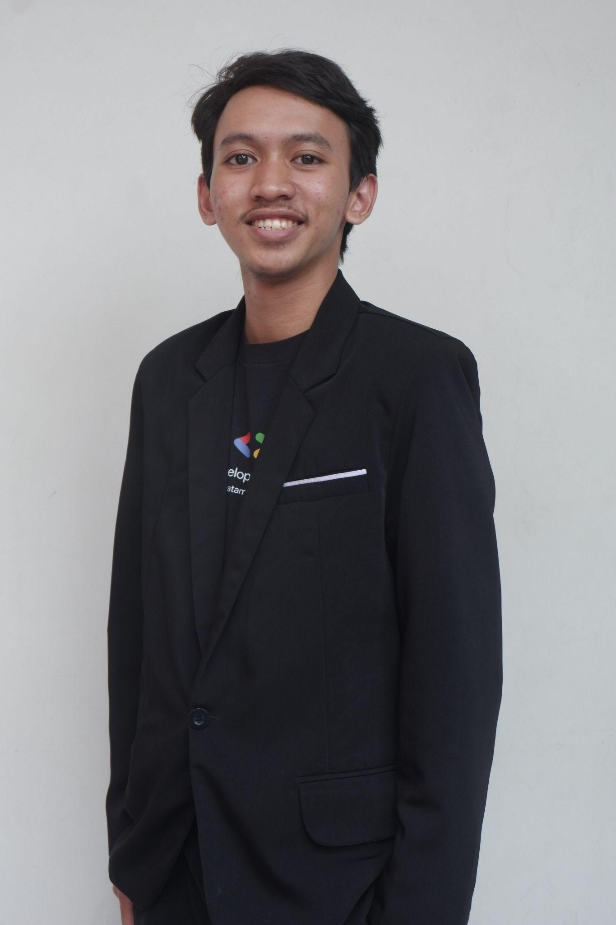




Co-Lead GDGoC Widyatama University
Informatics student at Widyatama University
Bangkit Alumni 2024 batch 1
On Campus Widyatama University
instagram.com/m.syahrindra
linkedin.com/in/m-syahrindra/
M Syahrindra Core Team
github.com/syahrindra

Slide 3
What to expect
Rules
Pengenalan mendasar mengenai bahasa pemrograman python di machine learning
Proactive
Tetap konduktif
On-cam jika memungkinkan

